Slide 1

DOB Safety Violations
Team Members
Harsha Chakravarthy B
Premchand M
Kasthur Reddy P
Neha Narayanadas V

Slide 2
About Dataset
This data set includes violations issued on devices through the New York City Department of Buildings' DOB NOW: Safety Violations module. The data is collected because the Department of Buildings tracks violation issuance and related information. This data include items such as violations number, violations type, violation issuance data, and BIN.
Dataset Info
Columns :24
Rows :593k

Slide 3

Objective:
The Main Objective of the project is to uncover insights regarding the Violations.
To Identify where the most and regular violations recorded and what are main types of violations and pattern of violations.

Slide 4
Exploratory Data Analysis
An Analysis approach that identifies general patterns in the data . These patterns include outliers and features of the data that might be unexpected
Why EDA:
The main purpose of EDA is to help look at data before making any assumptions .It can help identify obvious errors, as well as better understand patterns within the data, detect outliers or anomalous events, find interesting relations among the variables.

Slide 5
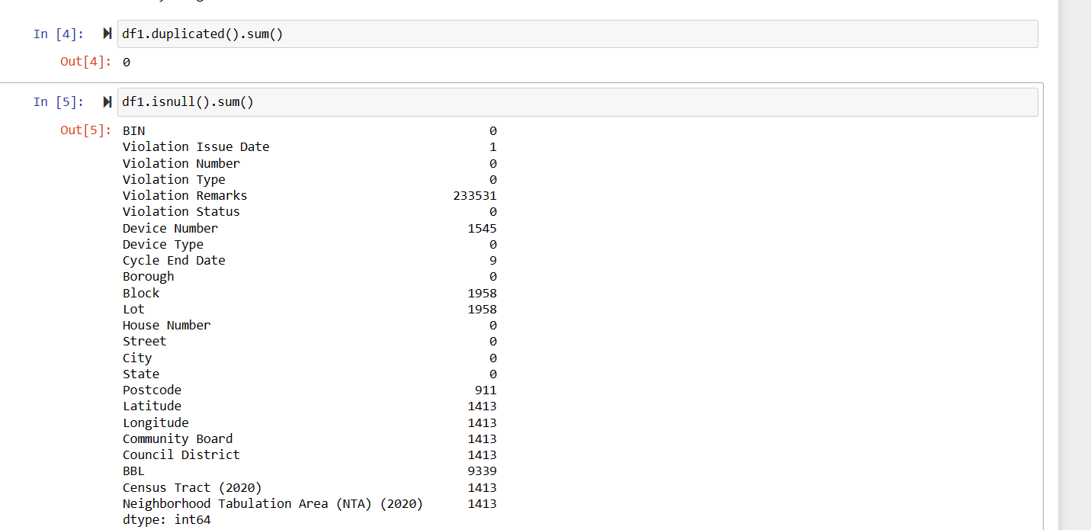
Before Performing EDA

Slide 6
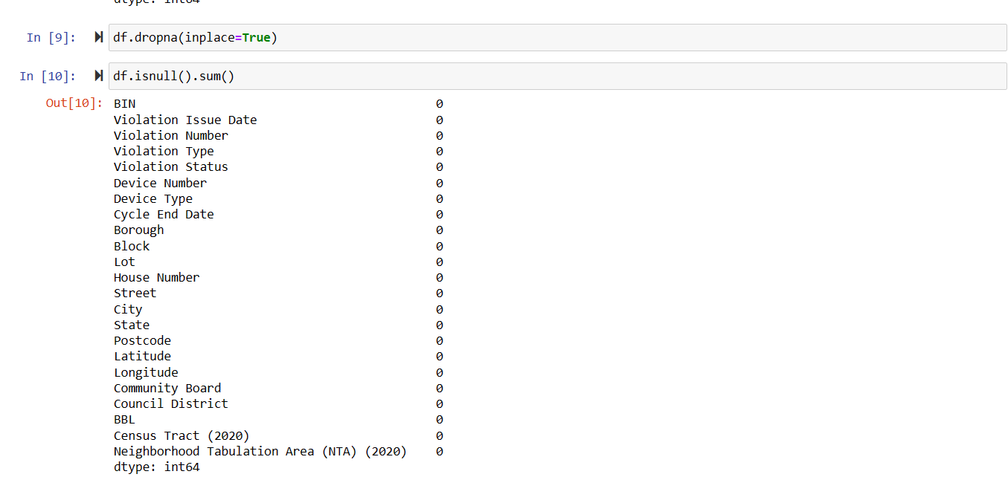
After Performing EDA

Slide 7
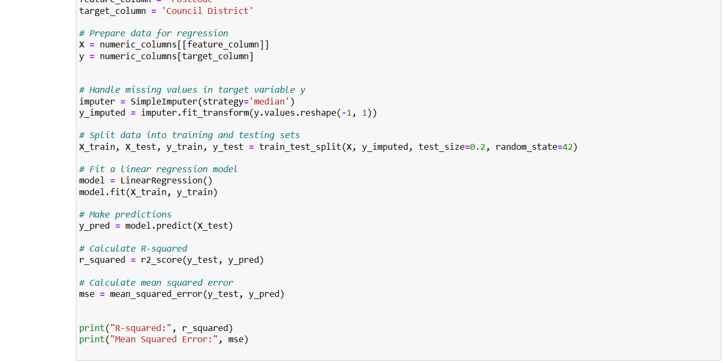
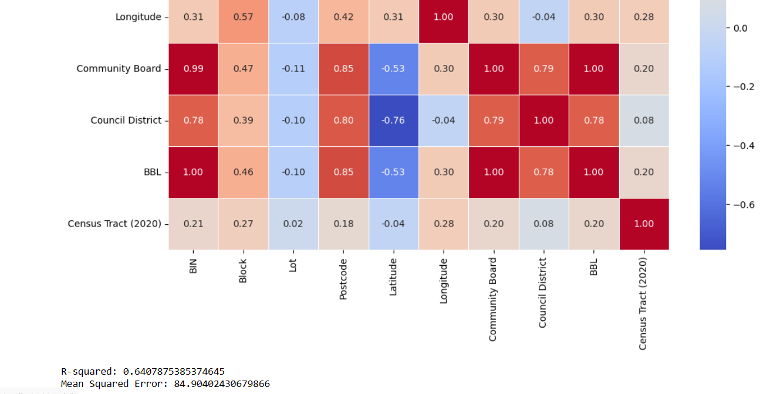
Linear Regression
Linear regression predicts the relationship between two variables by assuming a linear connection between the independent and dependent variables. It seeks the optimal line that minimizes the sum of squared differences between predicted and actual values.

Slide 8
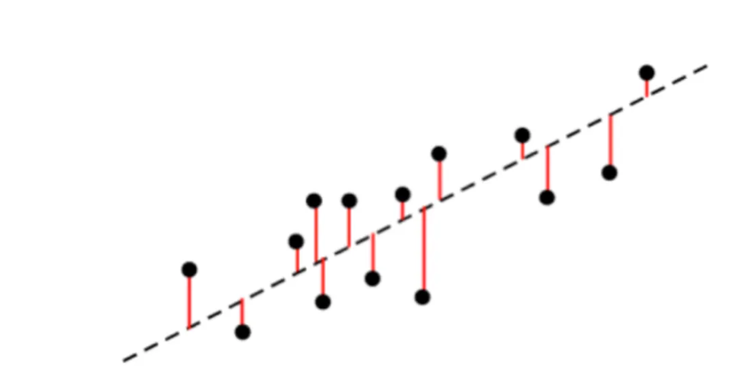
R-squared (R2)
R-squared (R2) is a statistical measure that represents the proportion of the variance in the dependent variable that is explained by the independent variables in a regression model.
Mean Squared Error
Mean Squared Error (MSE) is a measure of the average squared difference between predicted values and actual values in a regression model.

Slide 9
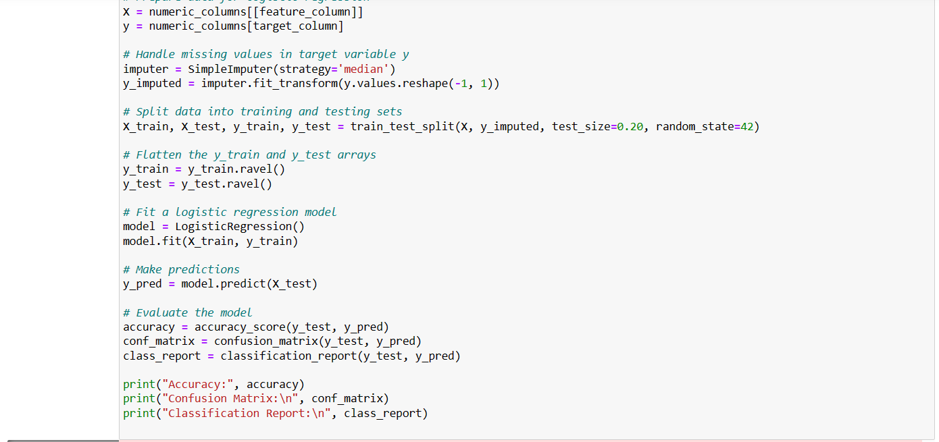
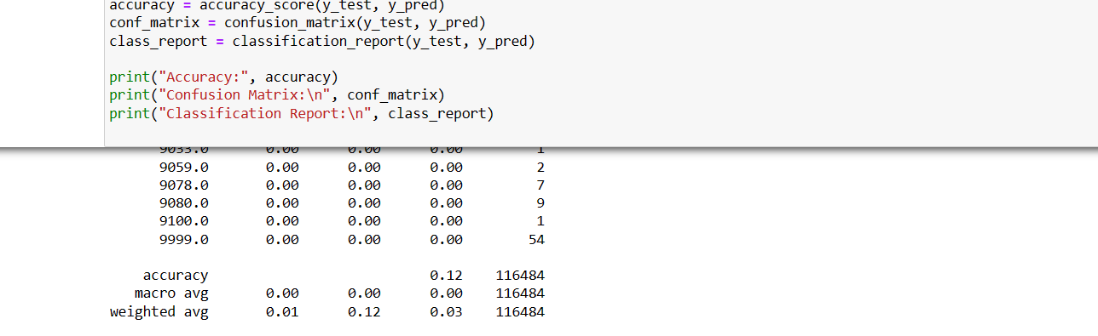
Logistic Regression
Logistic regression is defined as a supervised machine learning algorithm that accomplishes binary classification tasks by predicting the probability of an outcome, event, or observation.

Slide 10
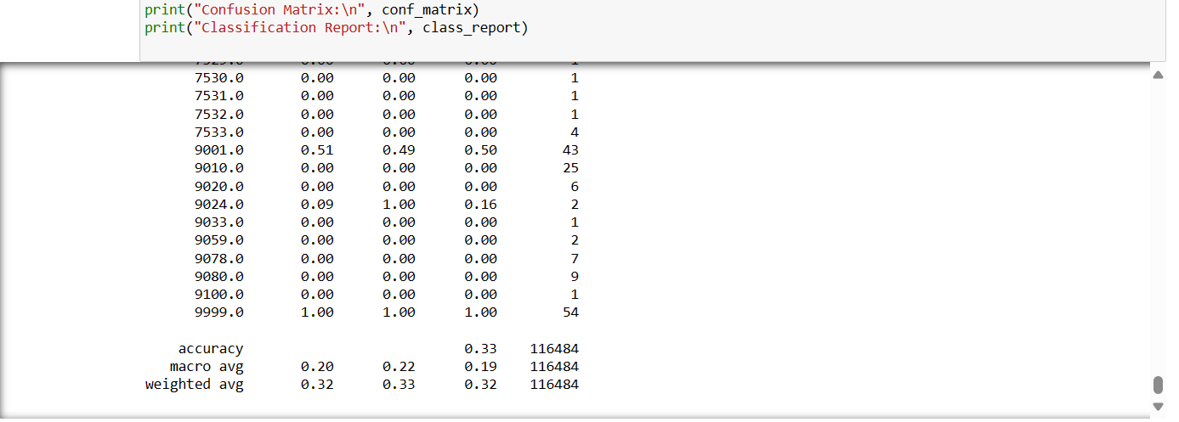
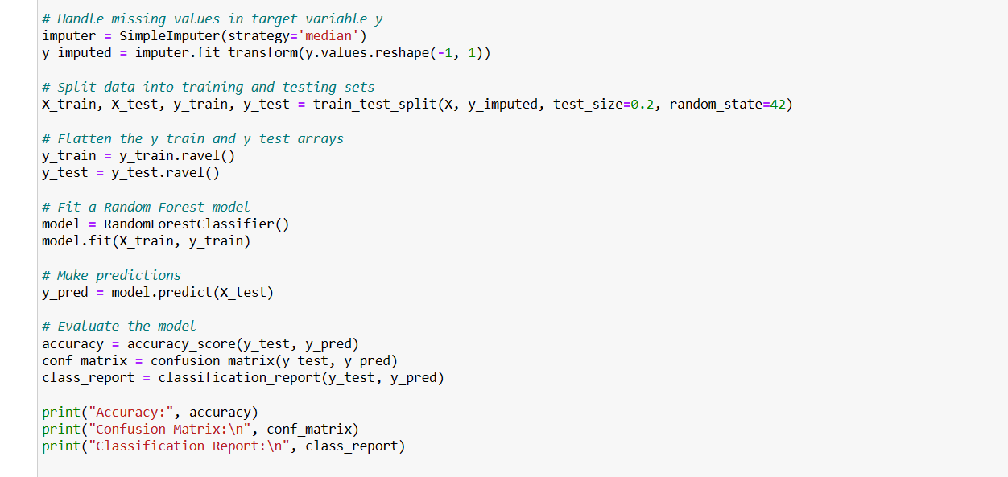
Random Forest Classifier
Random forest is a commonly-used machine learning algorithm, trademarked by Leo Breiman and Adele Cutler, that combines the output of multiple decision trees to reach a single result. Its ease of use and flexibility have fueled its adoption, as it handles both classification and regression problems.

Slide 11
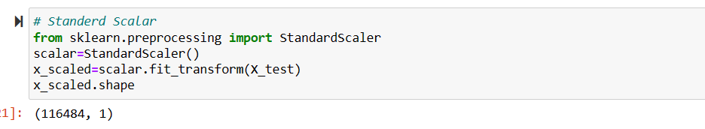
Standard Scalar:
StandardScaler, a popular preprocessing technique provided by scikit-learn, offers a simple yet effective method for standardizing feature values.
The transformation performed by StandardScaler can be expressed mathematically as:
z=x−μ/σ

Slide 12
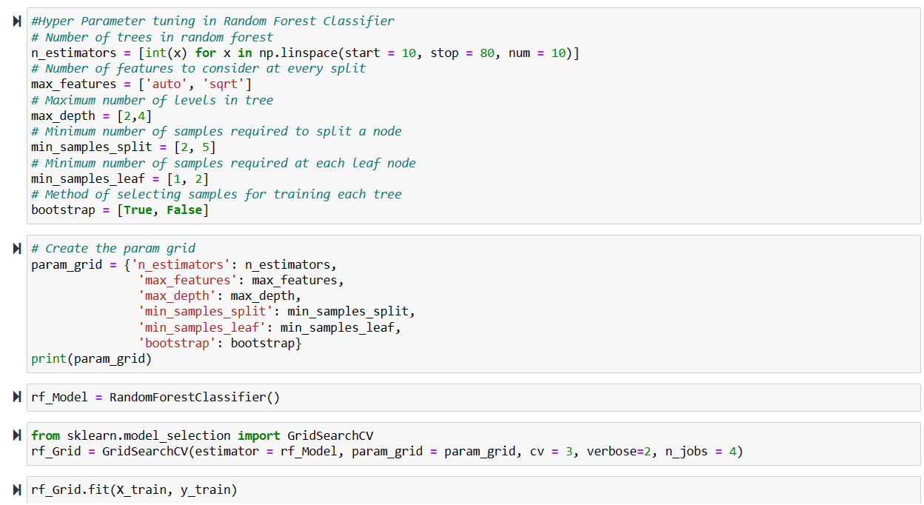
Hyper parameter tuning for Random Forest Classifier:
Sklearn supports Hyperparameter Tuning algorithms
that help to fine-tune the Machine learning models.
In this article, we shall use two different
Hyperparameter Tuning i.e., GridSearchCV and
RandomizedSearchCV.
We used GridSearchCV in this one.
With the parameters
With the use of HyperTuning we improve the accuracy
Of the training data.

Slide 13
Thank You
Harsha Chakravarthy B
Premchand M
Kasthur Reddy P
Neha Narayanadas V

